Slide 1
Writing Messages
The messages used in the workplace fall into four general categories:
Informative
Positive
Negative
Persuasive

Slide 2
…
Informative Messages
Informative message aims to provide necessary information, prompt understanding, and provoke neutral or positive responses while minimizing negative aspects.
Informative message also strives to uphold a positive image of the sender and the organization by providing complete details.

Slide 3
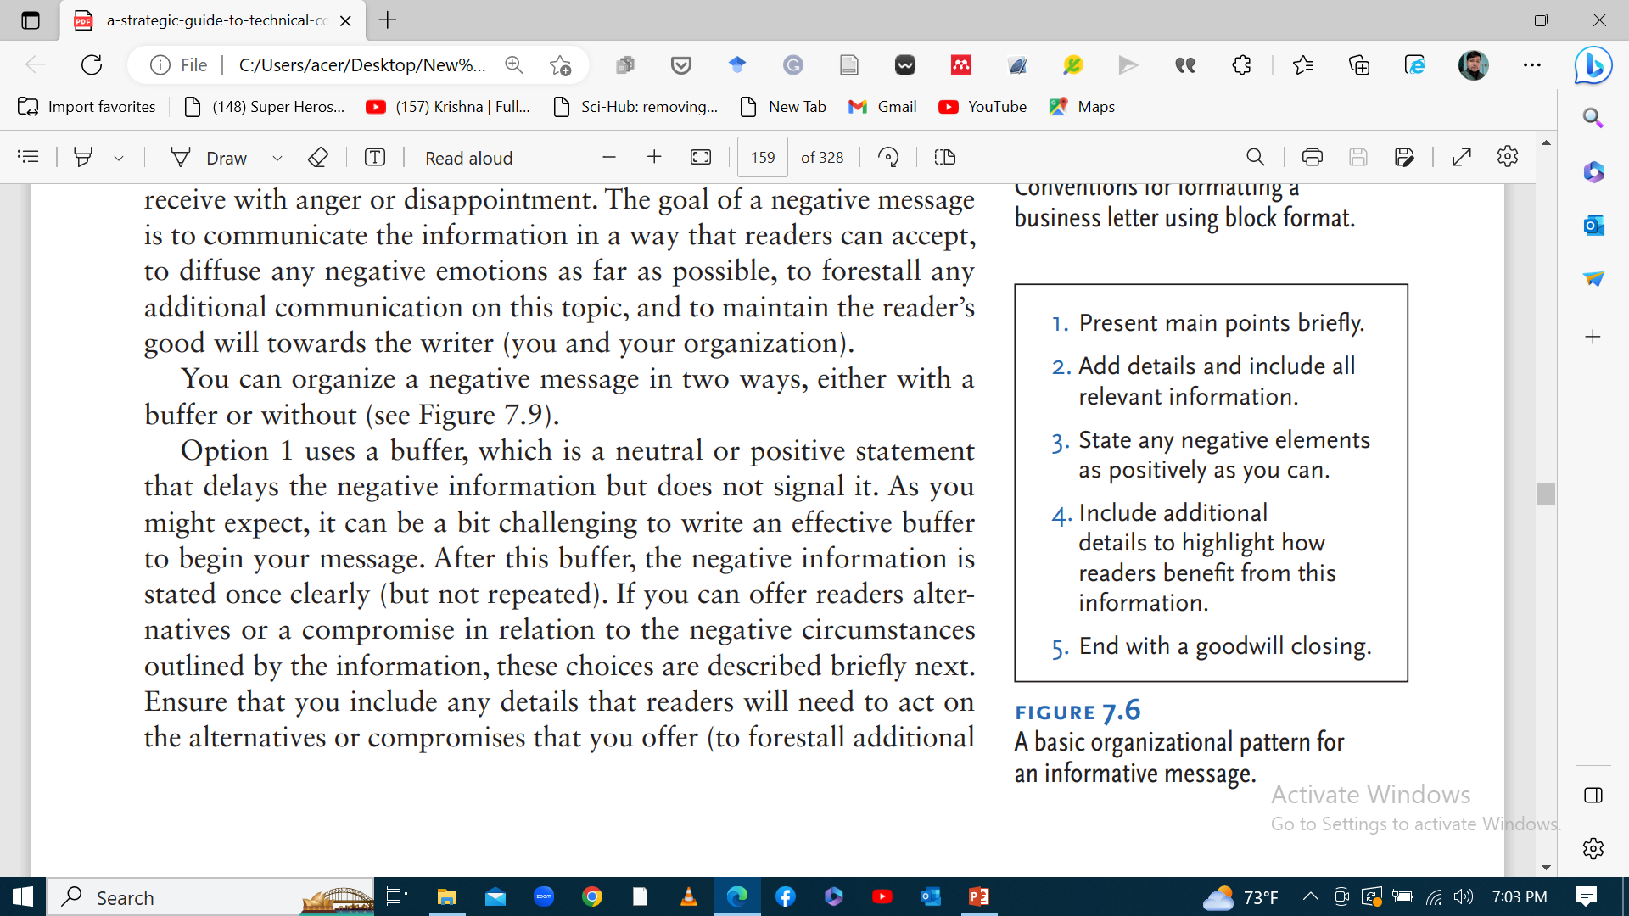

Slide 4
Sample of Informative Message
To: All Team Members
From: Event co-ordinator
Date: 25th Dec, 2024
Subject: Invitation to Participate in Employee Training Workshop
We are pleased to invite you to participate in our upcoming training workshop focused on [topic]. This workshop aims to equip participants with essential skills and knowledge to enhance performance and drive success in their respective roles. The workshop will cover topics such as [brief overview of workshop agenda]. Led by industry experts, this interactive session will be informative and engaging, offering valuable insights and practical strategies that can be applied in the workplace. The detail of the event is as follows:
Date:………….
Time:…………..
Venue:………….
We look forward to your participation and the opportunity to further invest in your professional development.
Best Regards
…………..

Slide 5
…
Positive Messages
Positive messages have several goals as sharing good news; restraining any negative elements; and ensuring that readers read, understand, and respond positively.
Its secondary goal- readers think well of the writer and that no further communication is needed on this topic.
pattern for organizing positive messages is similar to informative messages.

Slide 6
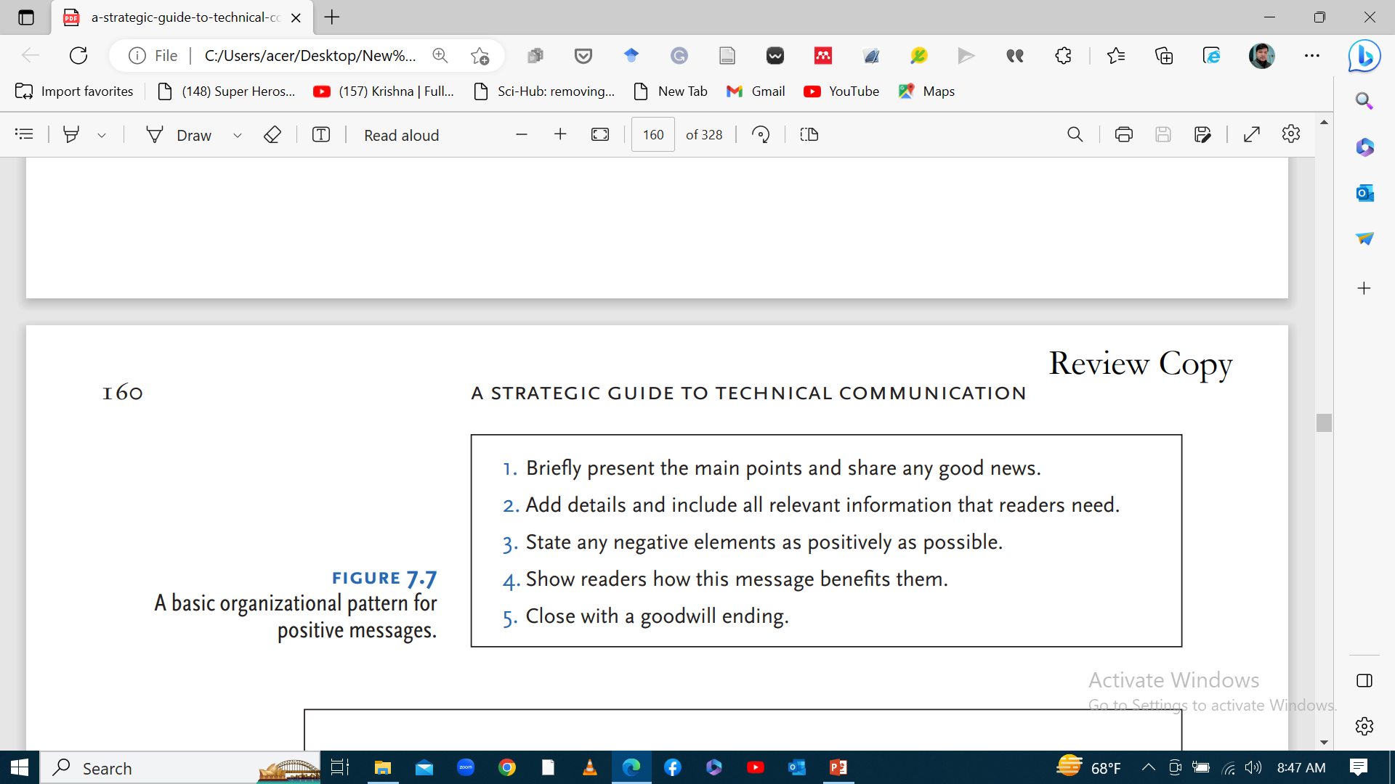
..

Slide 7
Sample of positive Message
Address: ………….
Date: ……………
Subject: Heartfelt Thanks for Your Positive Feedback
Dear [Customer's Name],
We express our sincere gratitude for your recent feedback regarding your experience with our product/service. Your kind words and review have truly brightened our day. Knowing that we've been able to meet and exceed your expectations fills us with immense pride. Your satisfaction is our top priority, and we're thrilled to hear that we've been able to make a positive impact.
Thank you for choosing us and for providing us the opportunity to serve you. We look forward to continuing to exceed your expectations in the future.
Warmest Regards,
[Your Name]
[Your Position]

Slide 8
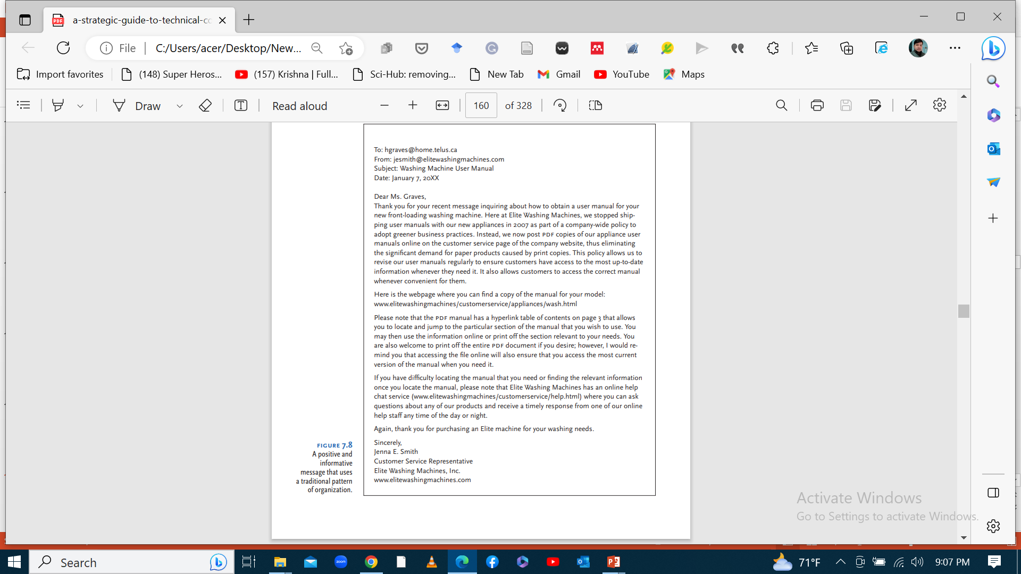

Slide 9
…
Negative Messages
Negative messages are those that you expect readers to receive with anger or disappointment.
Its goal is to communicate the information in a way that readers can accept
Need to diffuse any negative emotions and to maintain reader’s good will towards the writer
You can organize a negative message with a buffer statement
Buffer is a neutral/positive statement that delays the negative information
Postponement of program/meeting etc.

Slide 10
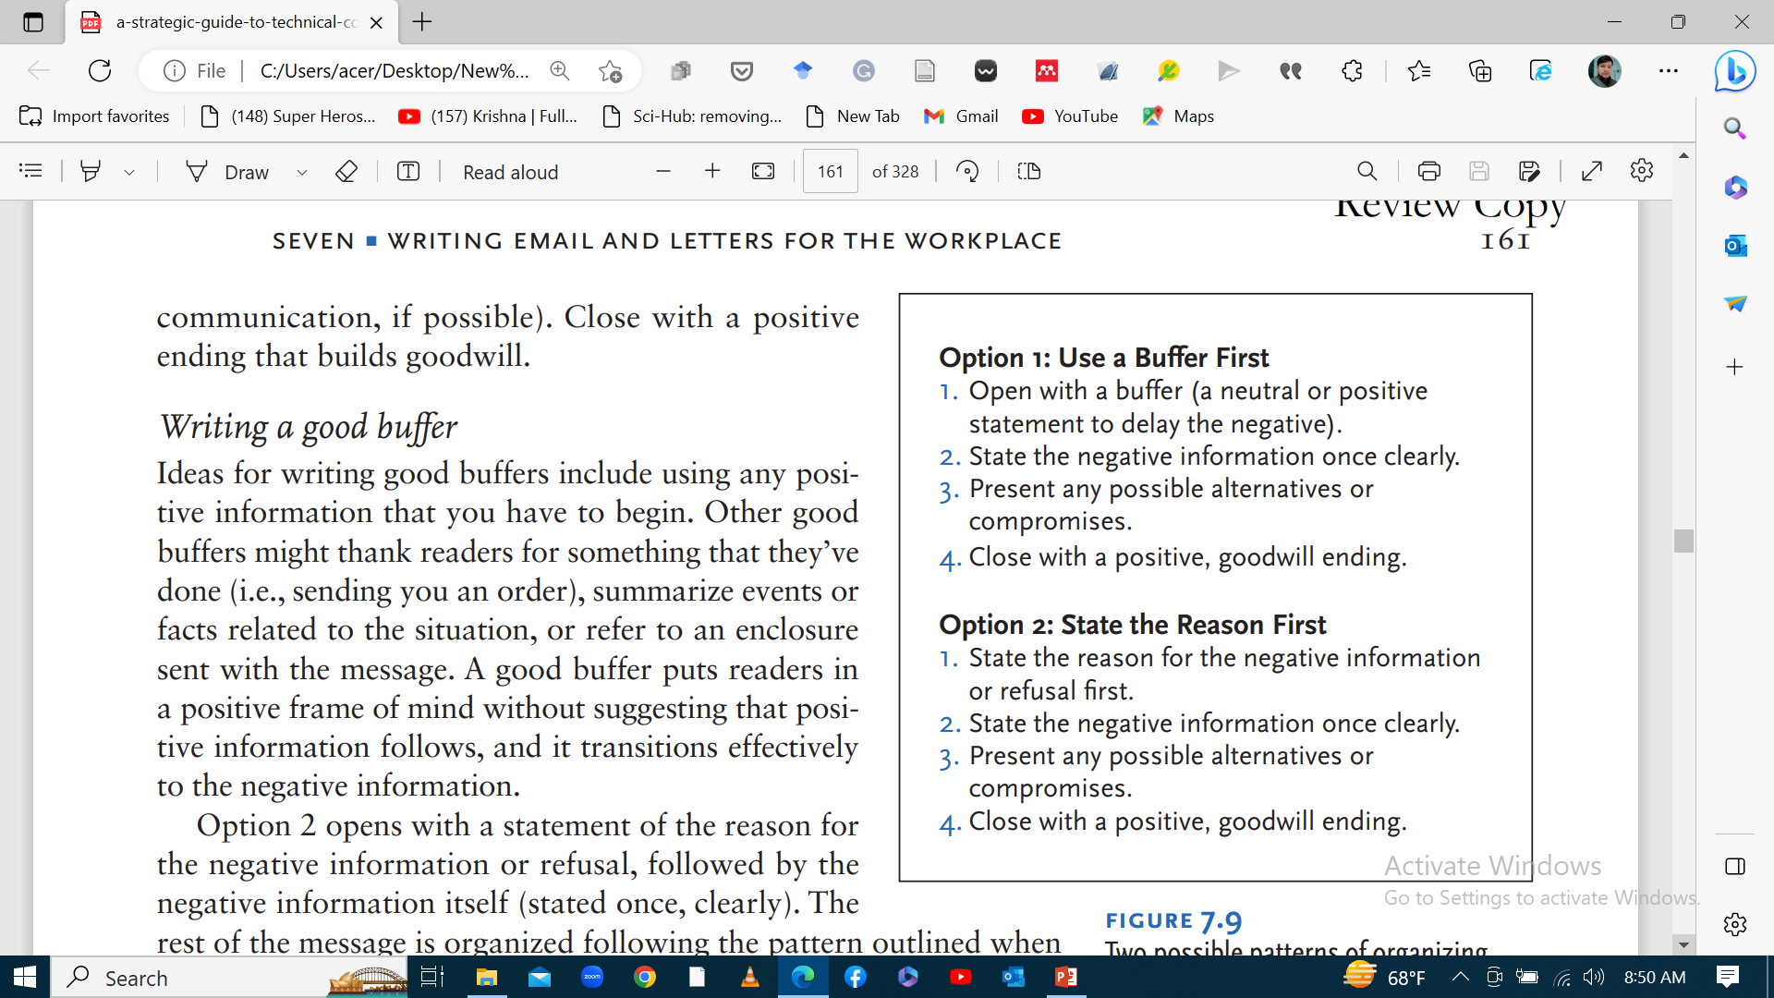
How to write negative message?

Slide 11
Indirect Approach: Rejecting Application Letter
Mega Bank Nepal Pvt. Ltd.
Darbarmarg, Kathmandu
Phone: 00977-23415675
www.megabanknepal.com
Sept 11, 2023
Dear Mr. Gupta,
Thank you for your interest in applying in Mega Bank Nepal. Our evaluation team was quite interested with your academic excellence along with your resume and cover letter. Despite the fact that your resume and cover letter were very impressive, our evaluation team did not select it for further consideration as it found another candidate's application and resume more relevant at this point of time.
We will, however, keep your resume on record and get in touch with you about future opportunities that may be a better fit for your skills and experiences.
We wish you all the best in your job search and hope we will have the chance to consider you for another role in the future.
Regards,
Ramesh Chand
(HR Manager)

Slide 12
Address: …………….
Date: …………..
Subject: Important Update Regarding [Program Name]
Dear Participants,
Thank you for your enthusiastic participation in [Program Name]. Unfortunately, due to unforeseen logistical challenges, we must postpone the program originally scheduled for [Date].
We are working diligently to address these issues and will reschedule at the earliest opportunity. Updates regarding the new date and any adjustments to the agenda will be shared soon. Your patience and support are greatly appreciated, and we remain committed to providing an enriching experience for all participants.
Best Regards,
[Your Name]
[Your Position]

Slide 13
…
Persuasive Messages
Persuasive messages are to persuade readers to take particular action.
Used in marketing, advertising, politics, fundraising, promotion etc.
Emotional appeal to persuade/ provide evidence
Persuasive messages fall into two categories:
a. Direct requests
b. Solution-finding messages.

Slide 14
a. Direct request messages
Asking readers to do something and people act when they are motivated.
Motivating readers involves understanding their thoughts and expecting any opposition to your request.
Identify potential obstacles by asking readers or analyzing the situation to understand causes of opposition.
Obstacles or objections often arise from three areas:
Emotional reasons- fear, frustration, anger, discomfort etc.
Practical reasons- lack of resource- time, money, equipment, prioritization and hostile demands, technical constraints, legal and ethical issues.
Misapprehension-misunderstanding/ misconception- incomplete, incorrect understanding- need clarification, open- minded.

Slide 15
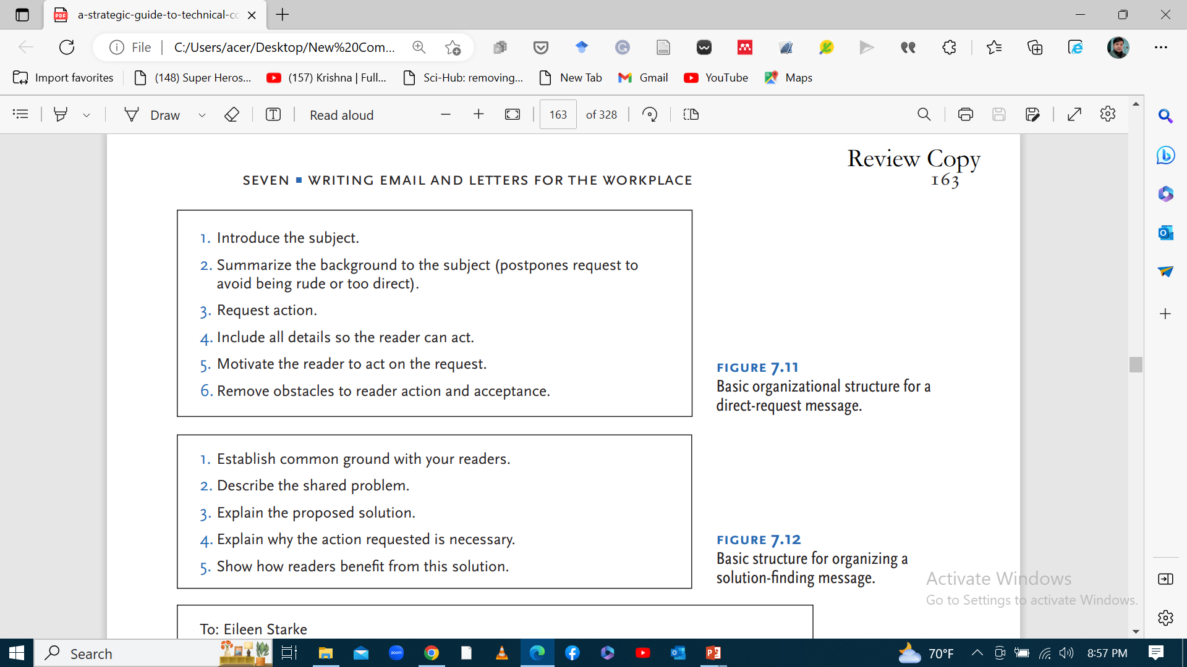
How to organize a direct request message

Slide 16
Request for Feedback on New Product Design:
To: ………..
From: ……………..
Date: ……………..
Subject: Your Input Needed: New Product Design
We value your opinion and would greatly appreciate your feedback on our latest product design. Your insights will help us to ensure that we're meeting your needs and expectations effectively. We understand that you may have concerns about the design process. It's important to us that you feel heard and that any misunderstandings are addressed promptly. Your input is vital in helping us to create a product that resounds with you. Please take a moment to review the attached design mock-ups and share your thoughts with us. Your feedback will guide us in refining the product to better serve you and our community.
Thank you for your time and consideration. We look forward to hearing from you soon.
Best Regards,
…….

Slide 17
…
b. Solution-finding messages
A solution-finding message generally identifies a problem and proposes a solution.
This type of message becomes persuasive when you encourage readers to accept (and act on) the solution that you propose.
Consider whether readers might object to your solution so that you can do ahead and overcome any potential obstacles.

Slide 18
How to organize a solution-finding message?

Slide 19
Proposal for Addressing Employee Burnout
Date: ………….
Subject: Addressing Employee Burnout - Proposal for Flexible Work Arrangements
Dear Employees,
It has come to our attention that many of us experienced the symptoms of burnout due to the increasing pressures of work environment. This is a shared challenge that we need to address collectively to ensure the well-being and productivity of our team. I propose implementing flexible work arrangements to empower employees with greater control over their schedules and workload, thereby reducing stress and maintaining productivity. I believe that with clear communication and well-defined expectations, we can effectively overcome any potential obstacles.
Additionally, offering support mechanisms such as regular check-ins and stress management resources can further enhance the success of this initiative. I encourage you to consider this proposal and welcome your input on how we can best implement flexible work arrangements to address employee burnout. Together, we can create a healthier and more sustainable work environment for everyone.
Thank you for your attention to this important matter.
Best Regards,
[Your Name]
[Your Position]

Slide 20
Assignment
Writing a Solution-Finding Email to Your Instructor
1. Let’s say you’ve just discovered that you will have to miss your next technical communication class because you have to attend the funeral of an extended family member, but you have an assignment due at the beginning of that class. Write an email message to your instructor using the information in the previous section and the organizational pattern outlined in Figure 7.3 to help you develop and structure your communication.
Remember, you need to both identify and solve the problem that your upcoming absence will create.
2. As a sales officer of your company, draft a persuasive sales letter targeting housewives to promote the sale of your recently manufactured electric milk boiler, highlighting its unique feature such as automatic cut, energy efficiency, easy cleaning, durable etc.

